Slide 1

Doctor’s Fees Prediction
Doctor
Fees
Prediction
Machine Learning Project
By SAGNIK ROY

Slide 2

Motivation &
Problem Statement

Slide 3
Motivation:
Increase in research interests in ML in Medical Science and Everyday work
Huge amount of un-licensed / public datasets available

Slide 4
Problem Statement :
In this time we all need doctors at any time for check-up or in any emergency. But we find that their wages or consultancy fees are too high also for a well-settled individual. Some charges are very high and some very low but have clinics in remote area. What if we can correlate the wages with other valuable information of the doctor and build a machine learning model that can predict the fees?

Slide 5

Dataset
Source &
Description

Slide 6
DATA DESCRIPTION
Link- https://kaggle.com/nitin194/doctor-fees-prediction
There are 2 datasets. – 1. Final Train
2. Final Test
Type of the dataset : excel type (.xlsx)
Size of the data : 1. Final Train : (5961 , 7)
2. Final Test : (1987 , 7)
Information of the features / attributes :
Qualification : object type data
Experience : object type data
Rating : object type data
Place : object type data
Profile : object type data
Miscellaneous Info : object type data
Fees : integer type data (only present in train dataset)

Slide 7

Data
Processing &
Feature
Engineering

Slide 8
Steps of creating Trainable Data:
Data Processing
Data Understanding
Primary Visualization
Unnecessary Feature Drop
Feature Engineering
Leakage Processing
Releasing constant and quasi-constant features
Exploratory Data Analysis
Deleting irregular data features
Encoding
Creation of Train and Test data
Notes:
Steps of data processing

Slide 9
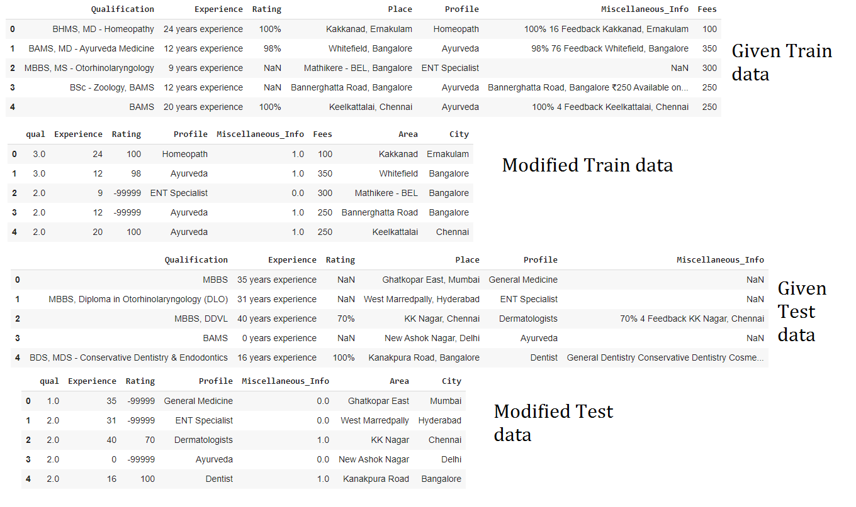
Notes:
In this section we can see we have organised the datasets through the steps of data processing (before encoding).

Slide 10
Exploratory
Data
Analysis

Slide 11
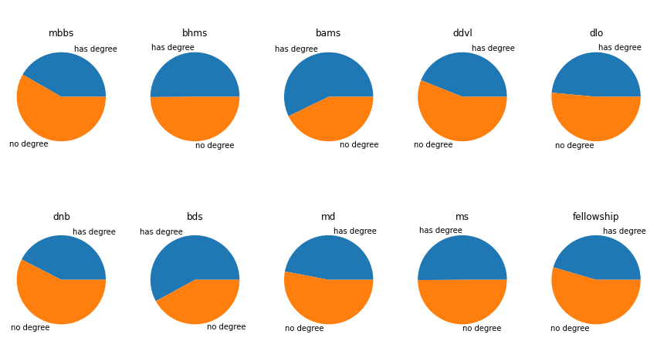
Fees over Qualification

Slide 12
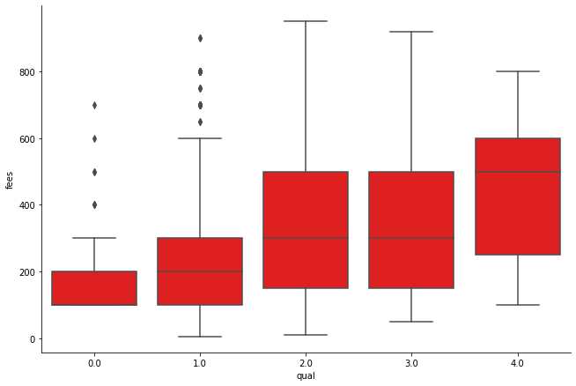
Overall Qualification V/s Fees
Notes:
This curves indicates that the summed up qualification surely affects the fees or wages of the doctor.

Slide 13
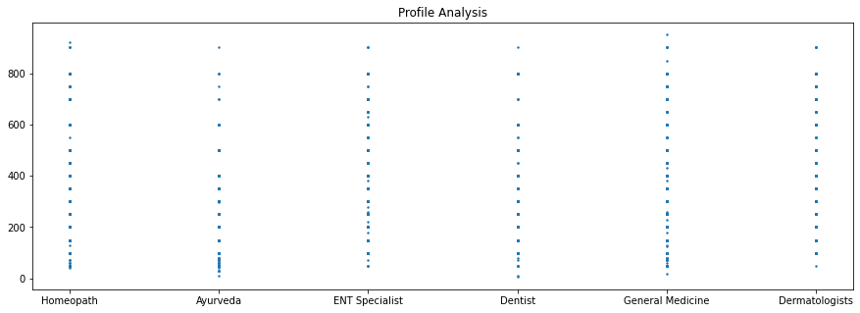
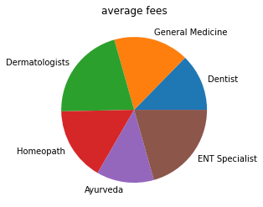
Profile V/s Fees
Notes:
Every single line distribution shows different behaviour to the fees.

Slide 14
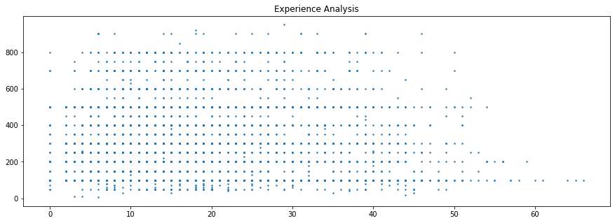
Experience V/s Fees

Slide 15
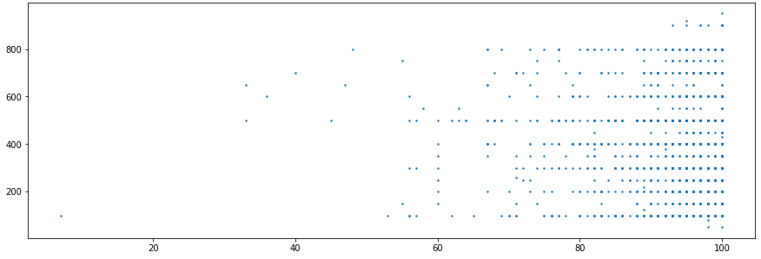
Rating V/s Fees

Slide 16
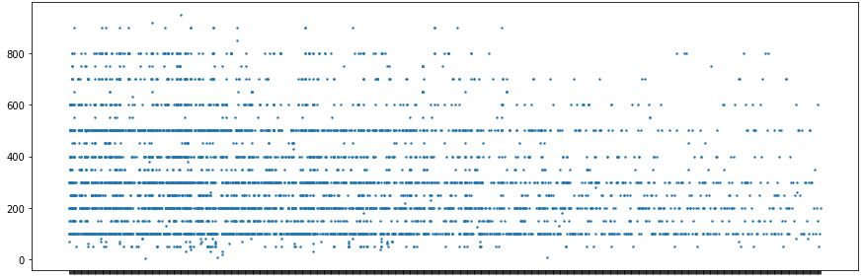
Area V/s Fees

Slide 17
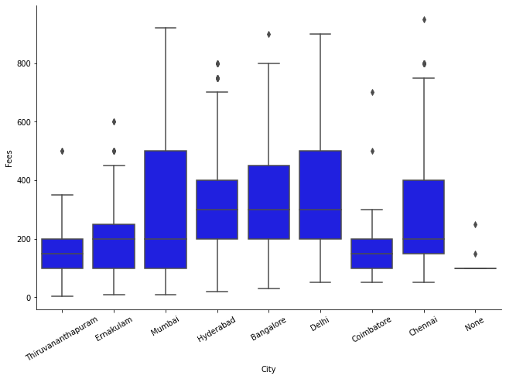
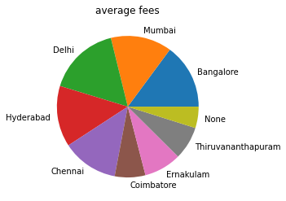
City V/s Fees

Slide 18
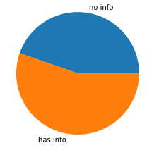
Miscellaneous Info V/s Fees
Notes:
This shows that having other information makes the doctor charge more or vice versa.

Slide 19
Model
Selection &
Evaluation

Slide 20
SELECTION :
Model Used : RandomForestRegressor
Model Library : sklearn (sci-kit learn)
Module : ensemble
Parameters : default
EVALUATION :
Model Evaluation Metric : Root Mean Squared Error (RMSE)
Model Performance on train data : 88.631%
Model Evaluation on train : 65.695
Model Evaluation on validation : 173.44

Slide 21
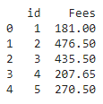
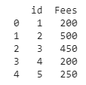
Model Deployment
Regression model Prediction :
Rounding off Prediction (deployment) :

Slide 22
Thank You

Slide 23
THE END

